Slide 1
Top-Down Network Design
Chapter Three
Characterizing the Existing Internetwork
Copyright 2010 Cisco Press & Priscilla Oppenheimer

Slide 2

Bắt đầu từ đâu?
Theo Abraham Lincoln:
  “If we could first know where we are and whether we are tending, we could better judge what to do and how to do it.”

Slide 3
Chúng ta ở đâu?
Đặc tả hệ thống mạng hiện có :
  Cơ sở hạ tầng mạng
    Cấu trúc logic (modularity, hierarchy, topology)
    Cấu trúc vật lý
  Đặt tên và địa chỉ
  Vị trí và kết nối
  Các hạn chế về môi trường và kiến trúc
  Sức khỏe hệ thống

Slide 4
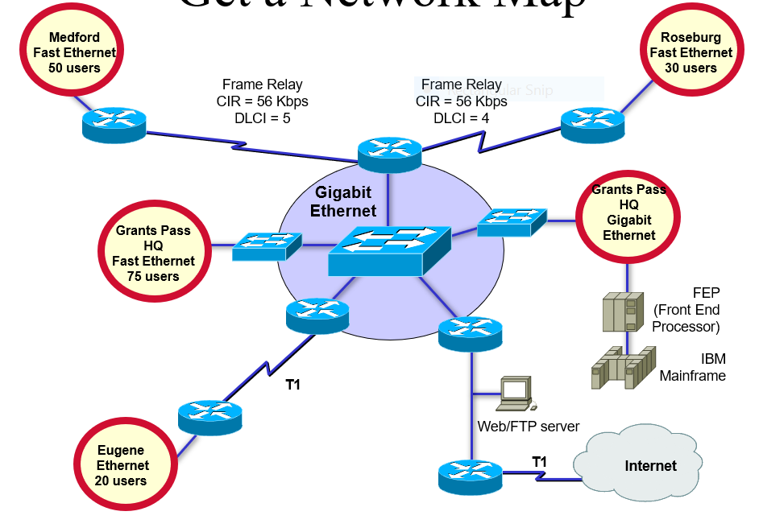

Mô hình mạng

Slide 5
Đặc tả mô hình đặt tên và địa chỉ
Địa chỉ IP của các thiết bị chính, mạng của client, mạng của server …
Các vấn đề còn tồn tại?
Có quy tắc đặc biệt trong việc đặt tên và địa chỉ không?
  Ví dụ:
    San Francisco = SFO, Oakland = OAK

Slide 6
Subnet không liên tục
Area 0
Network 192.168.49.0
Router A
Router B
Area 1
Subnets 10.108.16.0 - 10.108.31.0
Area 2
Subnets 10.108.32.0 - 10.108.47.0

Slide 7
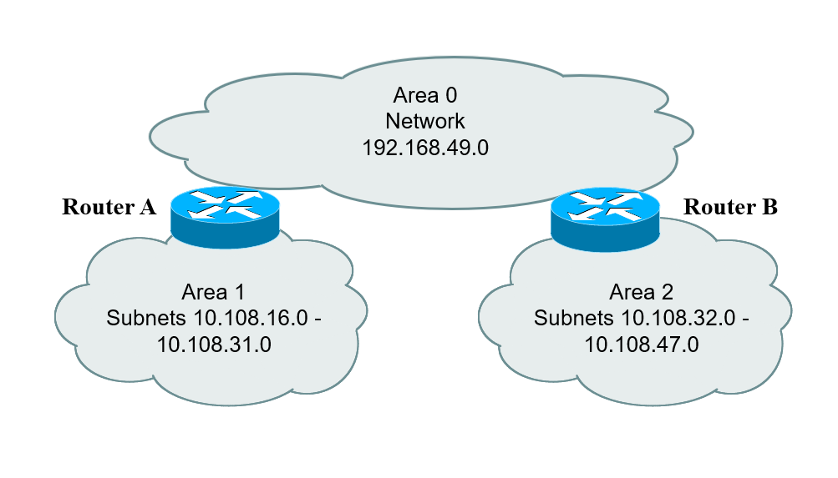
Subnet không liên tục

Slide 8
Đặc tả về kết nối
Single-mode fiber
Multi-mode fiber
Shielded twisted pair (STP) copper
Unshielded-twisted-pair (UTP) copper
Coaxial cable
Microwave
Laser
Radio
Infra-red

Slide 9
Campus Network Wiring
Horizontal
Wiring
Work-Area
Wiring
Wallplate
Telecommunications
Wiring Closet
Vertical
Wiring
(Building
Backbone)
Main Cross-Connect Room
(or Main Distribution Frame)
Intermediate Cross-Connect Room
(or Intermediate Distribution Frame)
Building A - Headquarters
Campus
Backbone
Building B

Slide 10
Các hạn chế kiến trúc
Đảm bảo các thành phần sau đây:
  Hệ thống điều hòa/Air conditioning
  Nhiệt độ/Heating
  Hệ thống thông gió/Ventilation
  Hệ thống nguồn/Power
  Bảo vệ điện từ trường / Protection from electromagnetic interference
  Hệ thống cửa/khóa/Doors that can lock

Slide 11
Các hạn chế kiến trúc
Đảm bảo các khoảng không dành cho:
  Ống dẫn cáp/Cabling conduits
  Patch panels
  Equipment racks
  Khu vực kỹ thuật dành cho việc installing and troubleshooting

Slide 12
Các vấn đề với wireless
Reflection/Phản xạ
Absorption/Hấp thụ
Refraction/Khúc xạ
Diffraction/Nhiễu xạ
Notes:
Reflection. Reflection causes the signal to bounce back on itself. The signal can interfere with itself in the air and affect the receiver’s ability to discriminate between the signal and noise in the environment. Reflection is caused by metal surfaces such as steel girders, scaffolding, shelving units, steel pillars, and metal doors. Implementing a Wireless LAN (WLAN) across a parking lot can be tricky because of metal cars that come and go.
Absorption. Some of the electromagnetic energy of the signal can be absorbed by the material in objects through which it passes, resulting in a reduced signal level. Water has significant absorption properties, and objects such as trees or thick wooden structures can have a high water content. Implementing a WLAN in a coffee shop can be tricky if there are large canisters of liquid coffee. Coffee-shop WLAN users have also noticed that people coming and going can affect the signal level. (On StarTrek, a non-human character once called a human “an ugly giant bag of mostly water”!)
Refraction. When an RF signal passes from a medium with one density into a medium with another density, the signal can be bent, much like light passing through a prism. The signal changes direction and may interfere with the non-refracted signal. It can take a different path and encounter other, unexpected obstructions, and arrive at recipients damaged or later than expected. As an example, a water tank not only introduces absorption, but the difference in density between the atmosphere and the water can bend the RF signal.
Diffraction. Diffraction, which is similar to refraction, results when a region through which the RF signal can pass easily is adjacent to a region in which reflective obstructions exist. Like refraction, the RF signal is bent around the edge of the diffractive region and can then interfere with that part of the RF signal that is not bent.

Slide 13
Kiểm tra sức khỏe của mạng
Performance
Availability
Bandwidth utilization
Accuracy
Efficiency
Response time
Status of major routers, switches, and firewalls

Slide 14
Characterize Availability
Date and Duration of Last Major Downtime
Cause of Last Major Downtime
Fix for Last Major Downtime
MTBF
MTTR
Enterprise
Segment 1
Segment 2
Segment n

Slide 15
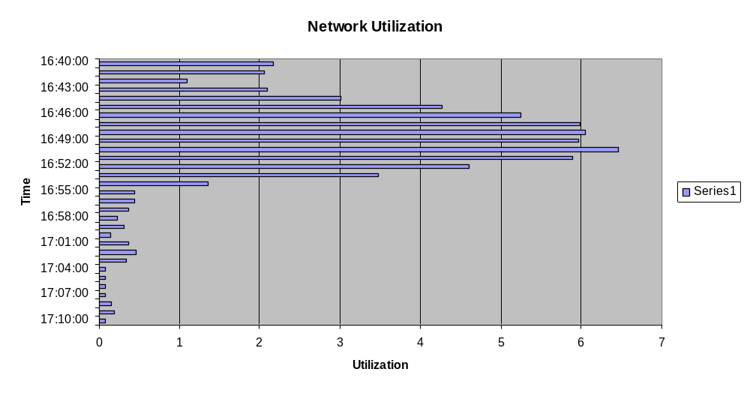
Network Utilization in Minute Intervals

Slide 16
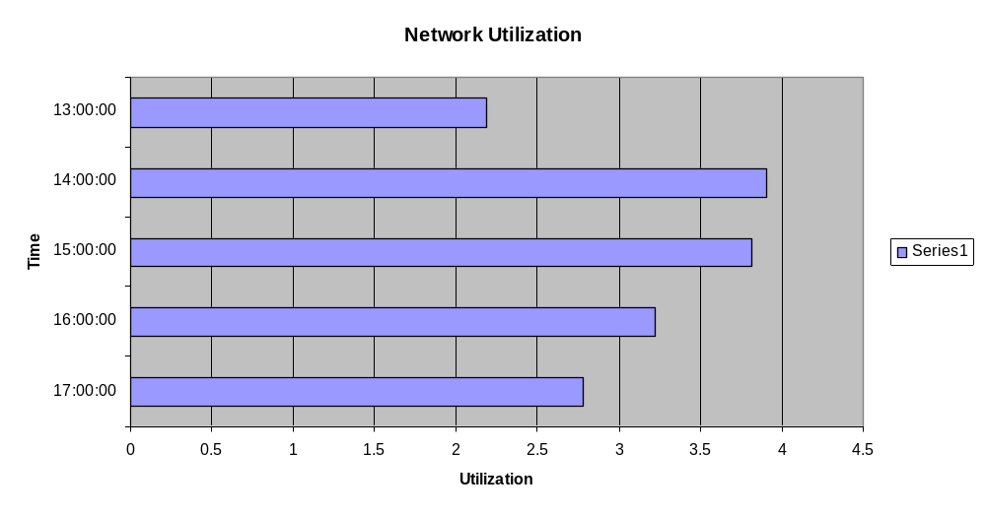
Network Utilization in Hour Intervals

Slide 17
Bandwidth Utilization by Protocol
Relative Network Utilization
Absolute Network Utilization
Broadcast Rate
Multicast Rate
Protocol 1
Protocol 2
Protocol 3
Protocol n
Notes:
Relative usage specifies how much bandwidth is used by the protocol in comparison to the total bandwidth currently in use on the segment. Absolute usage specifies how much bandwidth is used by the protocol in comparison to the total capacity of the segment (for example, in comparison to 100 Mbps on Fast Ethernet).

Slide 18
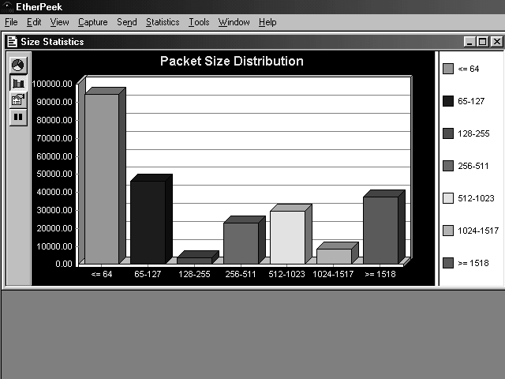
Characterize Packet Sizes

Slide 19
Characterize Response Time
Node A
Node B
Node C
Node D
Node A
Node B
Node C
Node D
X
X
X
X

Slide 20
Kiểm tra tình trạng của Routers, Switches, và Firewalls
show buffers
show environment
show interfaces
show memory
show processes
show running-config
show version

Slide 21
Các công cụ
Protocol analyzers
Multi Router Traffic Grapher (MRTG)
Remote monitoring (RMON) probes
Cisco Discovery Protocol (CDP)
Cisco IOS NetFlow technology
CiscoWorks

Slide 22
Summary
Characterize the existing internetwork before designing enhancements
Helps you verify that a customer’s design goals are realistic
Helps you locate where new equipment will go
Helps you cover yourself if the new network has problems due to unresolved problems in the old network

Slide 23
Review Questions
What factors will help you decide if the existing internetwork is in good enough shape to support new enhancements?
When considering protocol behavior, what is the difference between relative network utilization and absolute network utilization?
Why should you characterize the logical structure of an internetwork and not just the physical structure?
What architectural and environmental factors should you consider for a new wireless installation?

